Slide 2
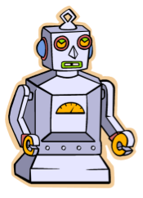
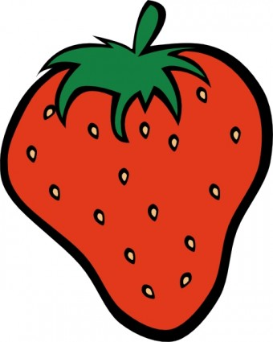
Revisit and Review
Robot word
a
a strawberry

Slide 3
Revisit and Review
Tricky Bugs

Slide 4
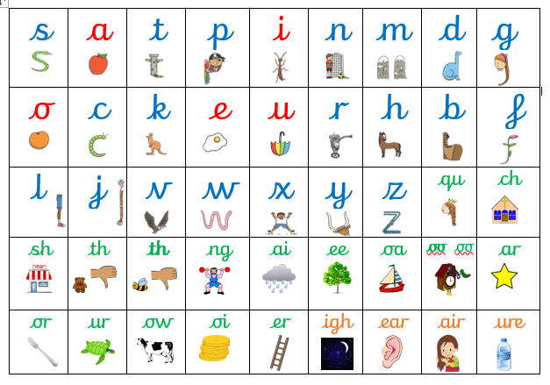
Revisit and Review
This is our Basic Code. It’s a tool for writing!

Slide 5
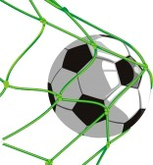
Learning Goal
I can hear and say the s phoneme

Slide 6
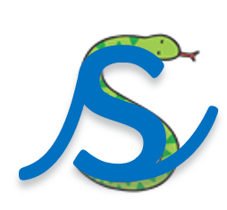
Say
Teach
Do
Say
Tune: The Farmer’s in his Den
The snake is in the grass.
The snake is in the grass.
/sss/ /sss/
The snake is in the grass.
Rhyme: Slide up and over to the snake’s long tongue. Watch out! Slide all the way round to his tail and then across the bottom to make a flick.
Notes:
6

Slide 7
Here are the single sounds.
They have a sound button
s

Slide 8
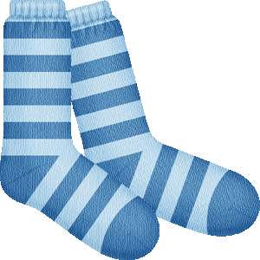
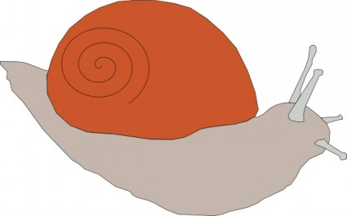
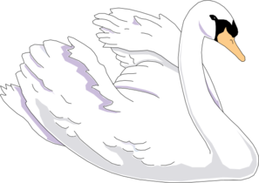
Practise

Slide 9
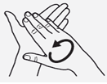
a word
Notes:
9

Slide 10
Practise
s u n
sun
Notes:
10

Slide 11
sat

Slide 12
sap

Slide 13
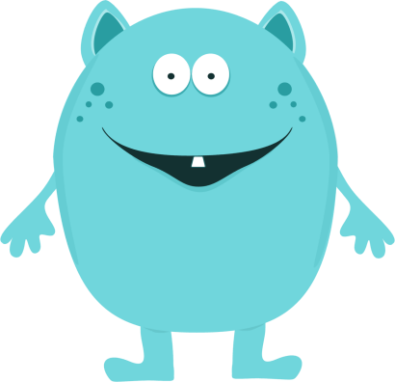
Revisit and Review
Monster Word
sut

Slide 14
